Slide 1
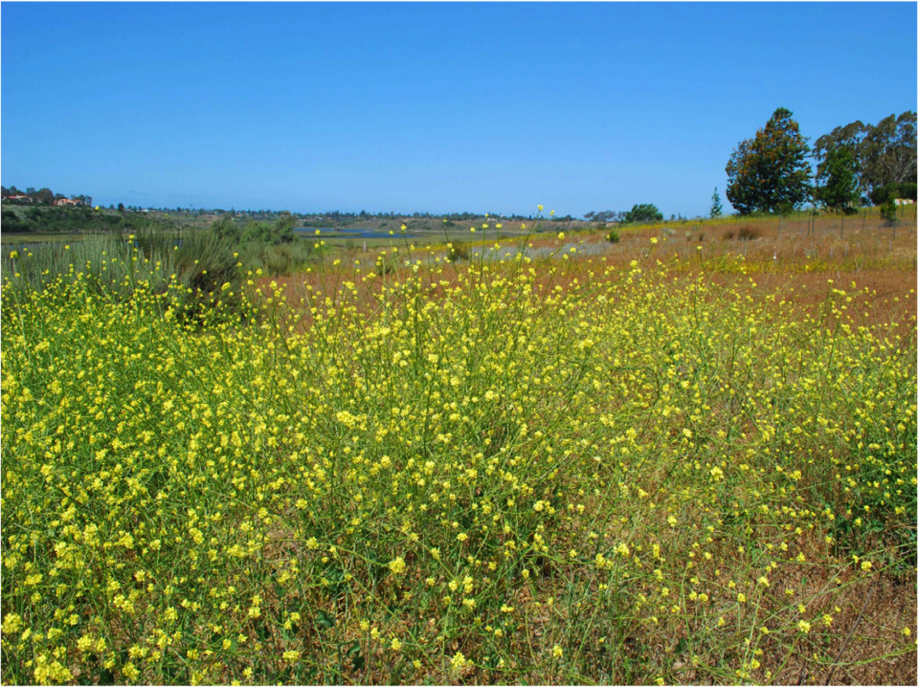
Plant and fungal community responses to different methods of Brassica removal
Riley T. Pratt, Stephanie N. Kivlin, Jessica D. Pratt,
Margaret B. Royall, Jennifer M. Talbot
Orange County Society for Conservation Biology
Notes:
Thank you for the invitation to speak today
My names is Riley Pratt and I am a founding member of the Orange county chapter of the Society for Conservation Biology.
We are one of 50 local chapters of the International Society that span 16 countries.
The broad mission of the Society is to promote the scientific study of biodiversity conservation and to disseminate that science through publications, primarily of the journal Conservation Biology and through regular international and regional scientific conferences.

Slide 2
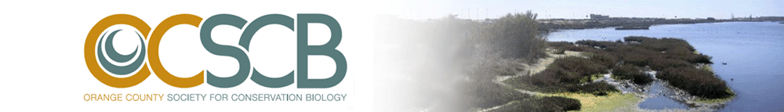
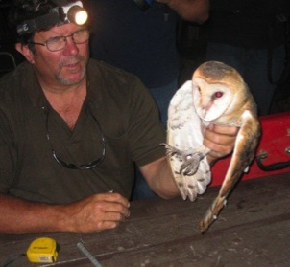
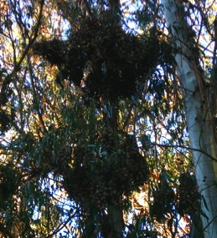
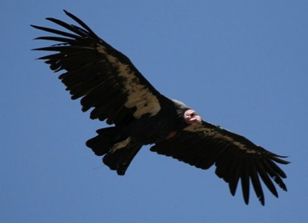
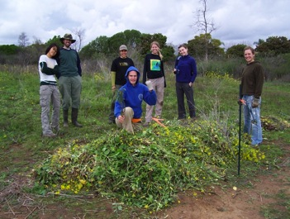
www.ocscb.org
Speaker Seminar Series
Field Trips
Restoration Projects & Research
Notes:
As a local chapter, we are primarily interested in promoting local conservation issues and research. We have achieved this thru a number of different activities since our start in 2006 including hosting a speaker series, organizing field trips, as well as doing hands on restoration research.
Today I want to share with you one research project that we started in 2009 that grew out of a CSS restoration project in the upper new port bay

Slide 3
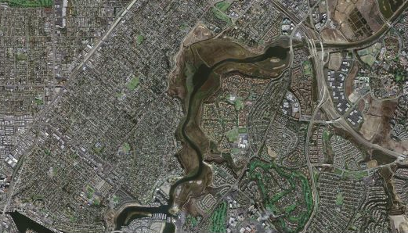
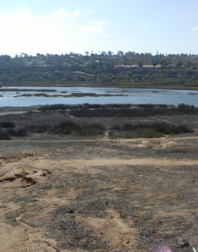



Upper Newport Bay Ecological Reserve: 752 Acres
Notes:
Background:
UNBER is a 750 acre estuary that contains a number of habitats including mudflats, saltmarsh, freshwater marsh, riparian, and upland habitat.
As you can see by the satellite photo is completely surrounded by urban areas.
The boxed area is the bayview slope and is the site of the restoration project I’m going to be talking about today.
This project was started in collaboration with Jeff Stoddard (DFG) and Matt Yurko (California Coastal Commission)

Slide 4
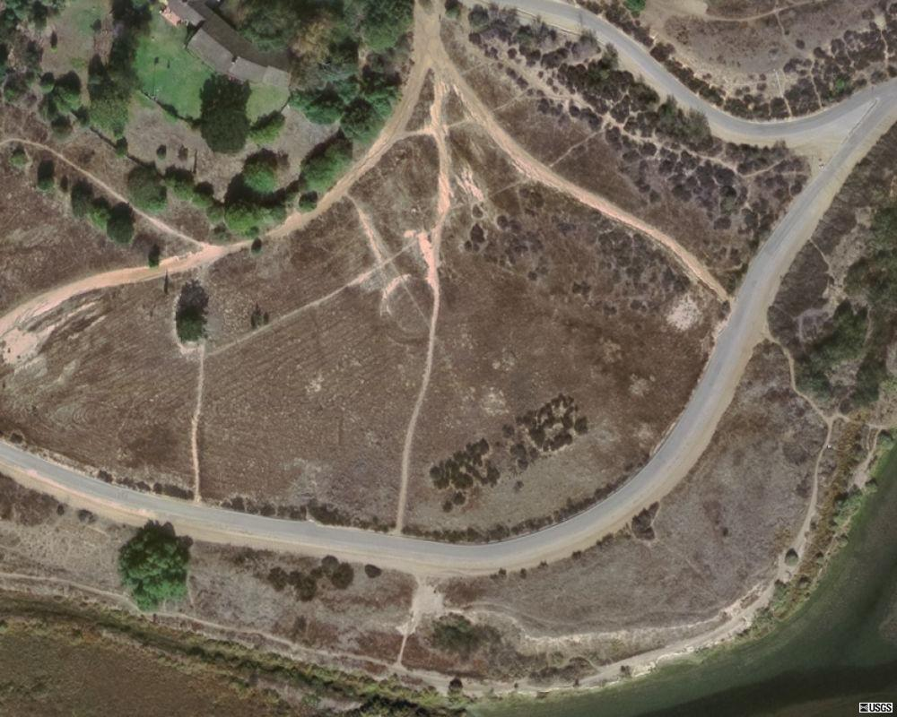
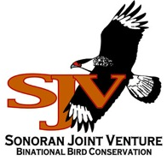
4.8 ACRE SLOPE
COASTAL SAGE SCRUB
NATIVE GRASSLAND
INVASIVES: BRASSICA AND ERODIUM SPP.
Notes:
The bayview slope is a 4.8 acre upland area under management by the DFG and County of Orange.
It was historically composed of CSS AND GRASSLAND MATRIX HABITAT, but is now highly disturbed with large populations of exotic and invasive plant species.
Parts of it are badly eroded and are crisscrossed with unauthorized trails.
In 2008 our chapter -- in partnership with the Coastal commission and OC -- applied for and received a $10,000 grant from the SJVF to begin restoration of the BVS primarily for bird habitat
(fund projects b/w resource agencies and non-profits to support conservation project in Mexico and the southwester US).
The project goals included:
Restore 4.8 acres of CSS & Grassland habitat to support the reproductive success of several avian species of concern
Monitor project site pre- & post- restoration by conducting area searches for these bird species
Host monthly events to educate and train the community in bird monitoring and restoration

Slide 5
Notes:
5
Like many disturbed scrub and grass land communities in southern California, the bayview slope at the time we began our restoration efforts was heavily invaded by exotic mustard species, primarily shortpod and field mustard.
Here is a view from the slope looking west toward the ocean.

Slide 6
Effects of Brassica Invasion on Ecosystems
Alter structure and composition of coastal sage scrub (CSS)
Disrupt native fungal communities on which many CSS plant species depend
Notes:
As any of you know, the establishment and spread of mustard species pose significant threat to CSS ecosystems.
Mustard often outcompetes natives for resources like water and light. So dense stands of mustard can alter the structure and composition of coastal sage scrub (CSS)
Unlike most of our natives, mustards are non-mycorrhizal and release chemicals into the soil that suppress mycorrhizal growth thereby disrupting native fungal communities on which many CSS plant species depend.
For these reasons, mustard removal is a major—if not the most time intensive-part of our restoration efforts. And when you spend a lot of time pulling mustard in a field covered in it, you wonder whether your are having any impact on the local population/stand and whether you would be more effective removing it some other way. It might be faster to mow or herbicide large stands, but could that have detrimental effects on the native plant species were hoping to increase or alter the soil environment in ways that might feedback negatively on our restoration efforts.
This led us to the idea of setting up a simple experiment to compare the effectiveness of commonly employed methods of mustard removal on several restoration-relevant parameters.

Slide 7

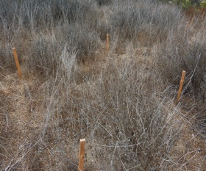
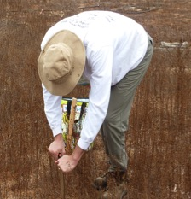
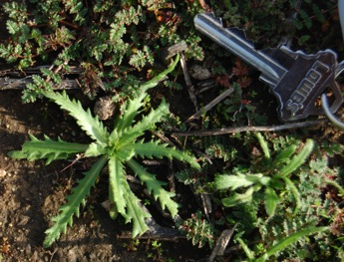
Establishing experimental Brassica removal plots
4 treatments x 4 reps. = 16 plots
Treatments:
Herbicide (2% glyphosate)
Mow
Hand-weed
Control
Treatments applied in Mar & Dec 2009 and Dec 2010
Responses Measured (Spring 2010-2012):
Percent cover of all plant species
Fungal hyphal length in soil
Notes:
In 2009 we applied for and received additional research funding from the Newport Bay Conservancy to establish the following Brassica removal experiment.
In March 2009 we established 16, 1x1 m experimental plots across a 3 acre area of the slope. We then randomly assigned each plot to one of three commonly used weed abatement treatments:
Herbicide application (2% glyphosate solution)
Mowing with a gas-powered string-trimmer (Figure 2).
Hand-weeding of mustard only, which was the removal method we were using on site
Negative control where we did nothing
Treatments were applied in March 2009 and again in early December 2009. We then reapplied the treatment the following December
In March 2010, 2011, and 2012, during peak growing season, we measured the percent cover of all plant species within plots.
Additionally, two soil samples from each plot were collected to estimate the density of fungal hyphae in soil (including mycorrhizal and saprotrophic fungi). The hyphae were extracted from five grams of soil, stained and quantified by grid-line intersect microscopy (2).
Extra
to assess the efficacy of three Brassica removal methods and their effects eliminating Brassica but also on native species richness and on the fungal communities.

Slide 8
Research Questions
How do different methods of Brassica removal impact:
Cover of Brassica species?
Overall cover of native and exotic vegetation?
Plant species composition?
Fungal biomass in soil?
Notes:
This experimental design allowed up to addrerss the following questions

Slide 9
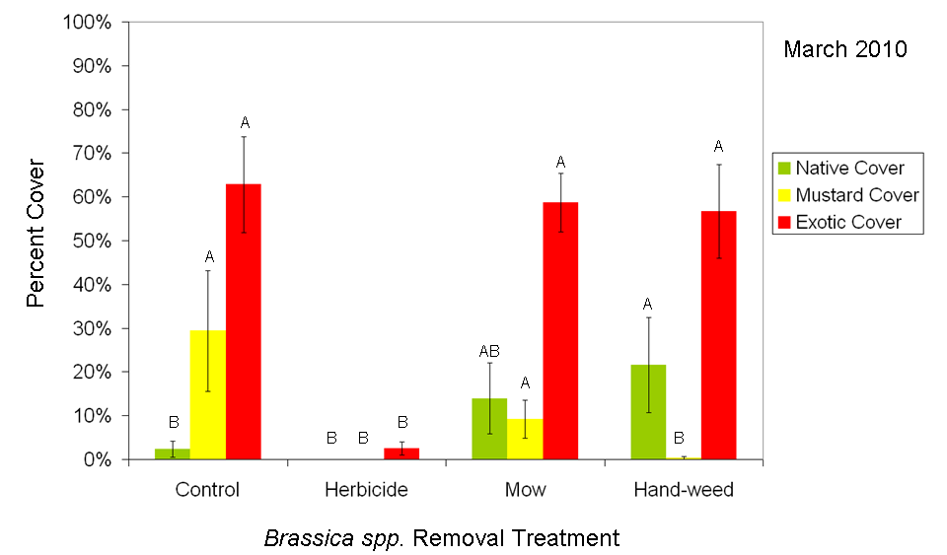
March 2010: Handweeding suppresses Brassica and promotes native plant cover more than controls
Removal Treatments
Native cover: F_{3,15} = 3.93, P=0.036; Brassica cover : F_{3,15} = 8.13, P = 0.003;
Non-Brassica exotic cover: F_{3,15} = 11.65, P < 0.001
Notes:
First, I’m going to show you the effect of the mustard removal treatments on overall native, mustard, and exotic plant cover. We’ve measured this over the last 3 years, starting at the end of March of 2010. This the first of 3 slides that look like this so I’ll walk you through this one first more carefully.
On the X axis are the three mustard removal treatment and the control. On the Y axis is percent cover
The colored bars represent the average percent cover of native plants in green, mustard in yellow, and all other exotics in red
Error bars represent standard errors
Letters indicate whether a given cover type significantly differ among the treatments. For example, native cover (in green) was significantly greater in hand-weeded plots than herbicide or control plots because the letters differ but does not differ from mowing (they share the letter A).
Looking at each treatment separately:
Herbicide: Herbicide reduced all plant cover, leaving a small amount of exotic cover
Mowing: Mowing did not significantly affect the amount of native cover or amount of exotic plant cover, including mustard.
Hand-weeding: Hand-weeding successfully reduced mustard cover and increased native plant cover relative to controls
Main point: Suggests that if you remove mustard, the space is filled primarily by native species

Slide 10
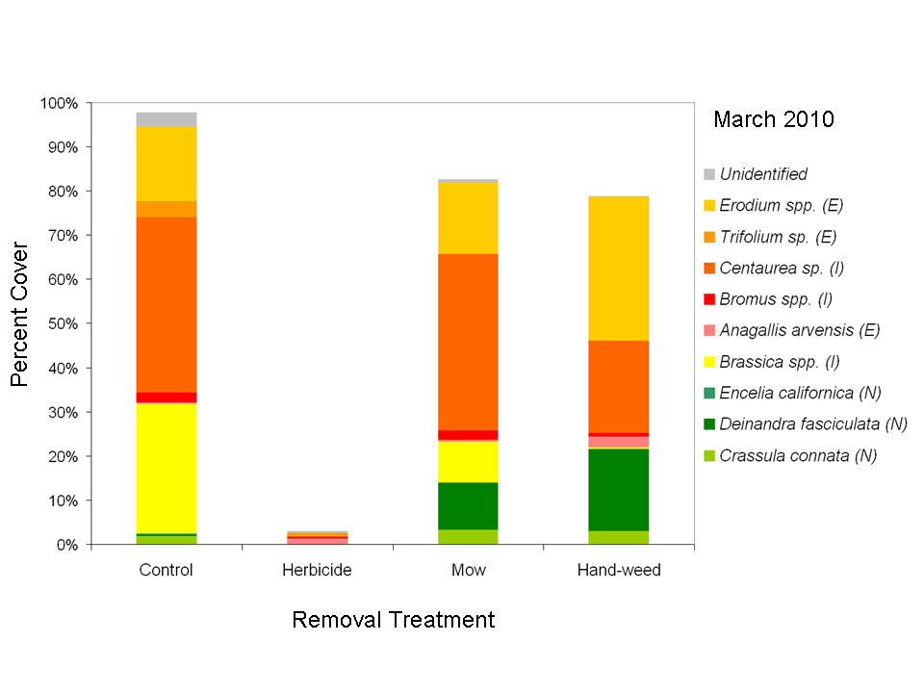
Mowing & handweeding ↓ Brassica and ↑ the native Deindandra fasiculata
Removal Treatments
MRPP T = -7.74, A=0.415, P < 0.0001
Notes:
I also wanted to show you what the compostion of plant species was in these plots.
So the axes here are the same, its just the bars depict the cover of each species in the plot. Native species are shaded of green, mustard in yellow, and all other exotics in orange and red. We can also see the communities are dominated by relatively weedy annuals.
Herbicide: Like the previous slide showed, herbicide reduced all plant cover, leaving a small amount of exotic cover, mostly Brome grasses and scarlet pimpernel
Mowing: Mowing reduced brassica cover and lead to an increase in tarweed relative to controls
Hand-weeding: Hand-weeding had a similar impact on species composition although it was more successful at eliminating mustard and promoting the growth of tarweed. Handweeding also appears to reduce Centaurea (tocalote) but may favor Erodium
A multivariate test MRPP (Multi-response Permutation Procedure) test indicates

Slide 11
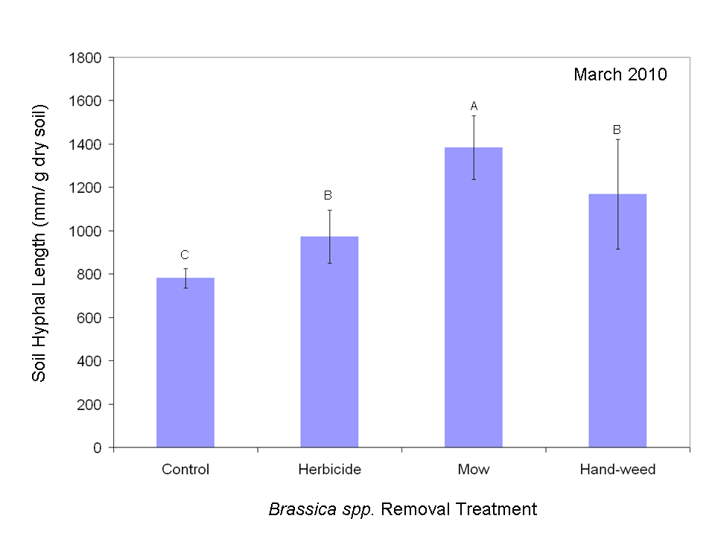
Brassica removal increases fungal biomass
Removal Treatments
F_{3,15} = 3.343, P = 0.038
Notes:
This graph shows soil hyphal length across the same treatments which reflects the abundance of all fungi in the soil
The main results to notice are:
1. The removal of Brassica increases fungal biomass in soils presumably b/c mustard secretes chemicals (e.g. glucosinolates) that have been shown to suppress fungal growth
2. Mowed plot had the greatest fungal biomass, which may have been a response to the added litter of the mowed plots.

Slide 12
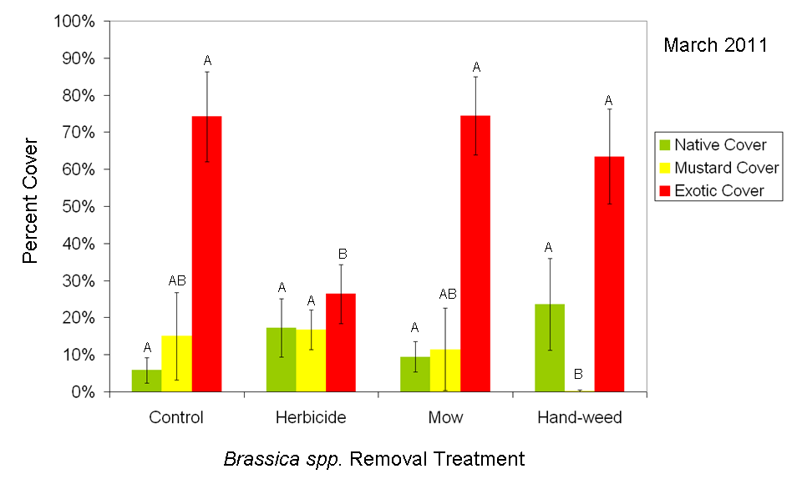
March 2011: Handweeding suppresses Brassica and promotes native plant cover more than controls
Removal Treatments
Native cover: F_{3,15} = 0.8, P=0.511; Brassica cover : F_{3,15} = 2.22, P = 0.138;
Non-Brassica exotic cover: F_{3,15} = 4.29, P =0.028
Notes:
We’re intersted in the effects brassica removal on all these response variables through 2011 and 2012 but today I’m only going to show you those for cover type
Results for 2011 show a very similar pattern to 2010, although the treatment effects are weaker (statistically) in 2011.
Importantly however, hand-weeding is still the only treatment where we have been successful at eliminating mustard through the middle of the growing season.
Herbicide – still depauperate in overall plant cover
Mowed plots still do not differ from controls
One of the most intersting difference between 2010 and 2011 is in the control plots where we saw a relative increase of native cover and decrease in mustard cover in control plots from last year. I think we can attribute this to the larger effort onsite to remove mustard so less seed is actually making it into the control plot and that space is in part getting fillled by natives.

Slide 13
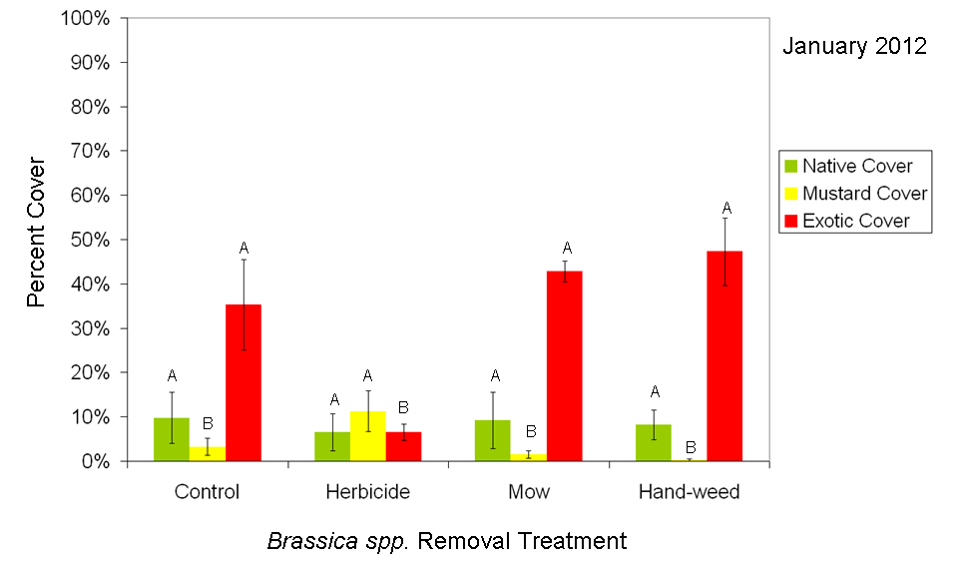
January 2012: Handweeding suppresses Brassica and promotes native plant cover more than controls
Removal Treatments
Native cover: F_{3,15} = 0.13, P=0.9397; Brassica cover : F_{3,15} = 7.2, P = 0.005;
Non-Brassica exotic cover: F_{3,15} = 7.86, P =0.004
Notes:
This data was collected a few weeks ago and early in the growing season so you can see that overall plant grow is low.
Herbicide plots remain largely bare but have the greatest cover of Brassica
Mowing and hand-weeding do not differ much from the controls at this point, suggesting mustard removal alone is unlikely to lead to an increase in native cover.
Hand-weeding does continue to be the only treatment that eliminates mustard however.

Slide 14
Summary
Herbicide
Reduced all plant cover types initially but currently has the highest cover of Brassica
Initially increased soil fungi compared to the control
Mowing
Did not affect Brassica, native, or exotic plant cover
Resulted in the greatest initial increase of soil fungi
Hand-weeding
Most effectively reduced Brassica cover and increased native plant cover.
Initially increased soil fungi compared to the control
Notes:
In summary, we do see meaningful differences among these treatments from a restoration perspective
The consequences of this increased fungal biomass is not clear but it could alter species compostion in the future by altering resource availabilty
Brassica species cover?
Overall native and exotic plant species cover?
Plant species composition?
Fungal biomass in soil?

Slide 15
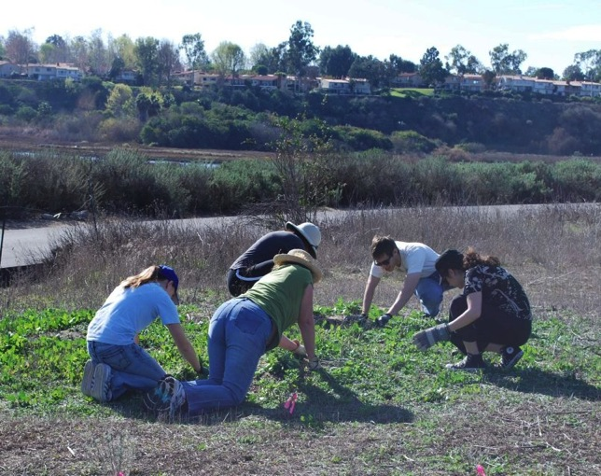
Is hand-weeding worth the effort?
Notes:
Conclusions
Based on our results, we will continue to control mustard by hand-weeding when possible and recommend it for restoration efforts of this size.
As effective as hand-weeding is at eliminating mustard, hand-weeded plots continue to be dominated by other exotic species and low in diversity and abundance of native species. So it is clearly insufficient to just pull mustard. A more comprehensive approach that includes weeding other non-natives, and seeding and planting natives needs to be part of the overall restoration strategy.
Mowing: We do not recommend mowing because it does not appear to have a strong impact on brassica long term or other cover types although it is worth looking more carefully at species composition from 2011 and 2012.
Mowing, however, prior to seed production may be helpful for reducing seed set of large, dense stands.
Herbicide: Herbicide may only be a good strategy if you are going plant/seed following application. On its own and applied over a general area, it leaves a lot of open space that may favor the colonization of Brassica long term. If individual mustard plants were precisely targeted, perhaps we would have seen a different outcome.
We are going to continue to look at how these removal treatments effect the soil environment and think about how that might alter the trajectory of the restoration at the site.

Slide 16
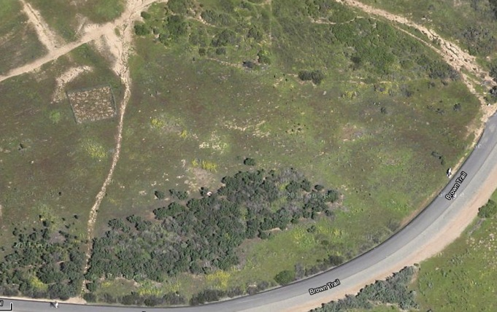
Acknowledgements
Research, design, data collection: Steve Allison, Bob Reed, Kathleen Treseder, and Numerous OCSCB volunteers
Collaborators: Matt Yurko (CCC), Jeff Stoddard (DFG), County of Orange Park and Rec
Funding: Sonoran Joint Venture Foundation, Newport Bay Conservancy
www.ocscb.org
Notes:
I want to thank all those that have been involved with the restoration project and experiment, the agencies and folks there we have been collaborating with, and our funding sources.
Most recent google image of site. I think it is interesting you can see the square patches of mustard corresponding to our plot locations (CO, especially). It is the only mustard left on the site!!
Brassica removal has been very successful on site!

Slide 17
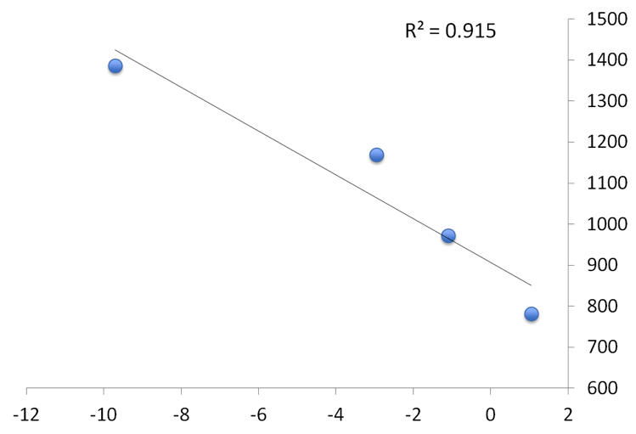
Soil fungi increase when soil nitrate declines
Mowing
Hand-weeding
Herbicide
Soil hyphal length (mm/g dry soil)
No treatment
% Change in soil NO₃⁻ after 1 month

Slide 18
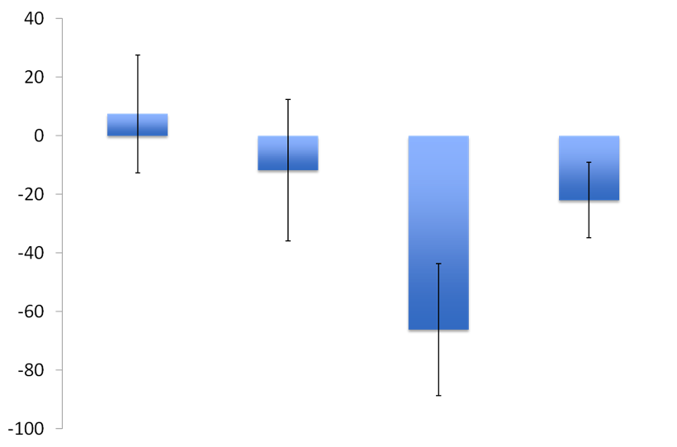
% Change in soil NO₃⁻ after 1 month
No treatment
Herbicide
Mowed
Hand-weeded

Slide 19
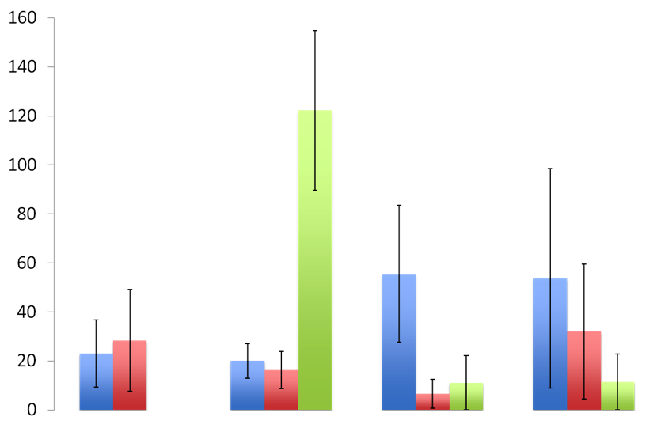
Pre-treatment
1 month
3 months
Soil NO₃⁻ (ug N/g soil)
No treatment
Herbicide
Mowed
Hand-weeded

